Slide 1
Allworx 48x Introductory Presentation
Allworx © 2010, All Rights Reserved

Slide 2
Bigger Simply is Better

Slide 3
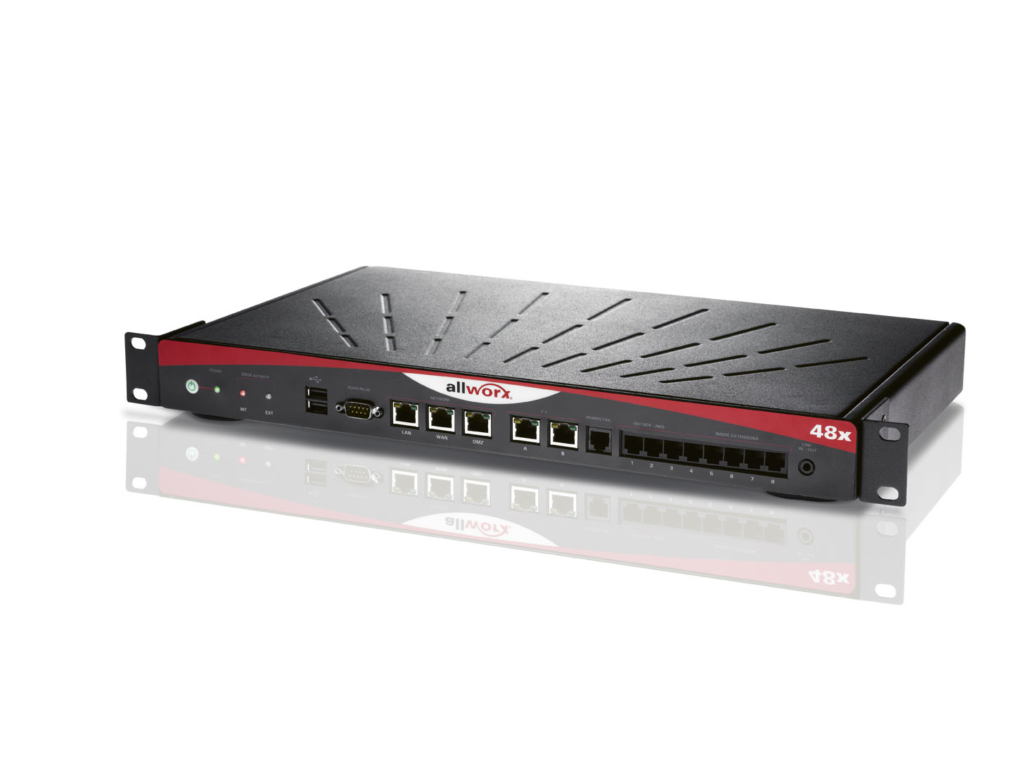
Allworx Is Proud To Introduce The New 48x
Smaller Form Factor
Significantly Increased Power and Performance

Slide 4
48x Quick Facts
48x built on the solid foundation established by the 24x
Same existing feature keys as 24x
Same user expansion licenses as 24x (49 to100, 101 to 150)
The 24 to 48 user license is no longer needed
Same Extended Warranty and Software maintenance
125 hours of total voicemail storage
Benefits
Bigger and broader market segment for new prospects
Migration options for existing customers
Same strategy of minimal part numbers for stock and support
User expansion license options on 48x - and 24x!
All 24x servers running 7.2 have growth to 250 users plus 250 extensions

Slide 5
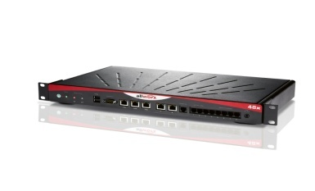
The New Allworx 48x
Dual T1 / PRI
Up to 250 users
Solid state drive (8GB) replaces hard disk
Larger Conference Bridge options
Better MOH, Paging interface

Slide 6
Technology Marches Forward
Hard Disk Drives soon to be “end of life”
Solid State Drives become standard
Rapid DSP performance improvements
Greater DSP performance, lower prices
Additional opportunity for improvements

Slide 7
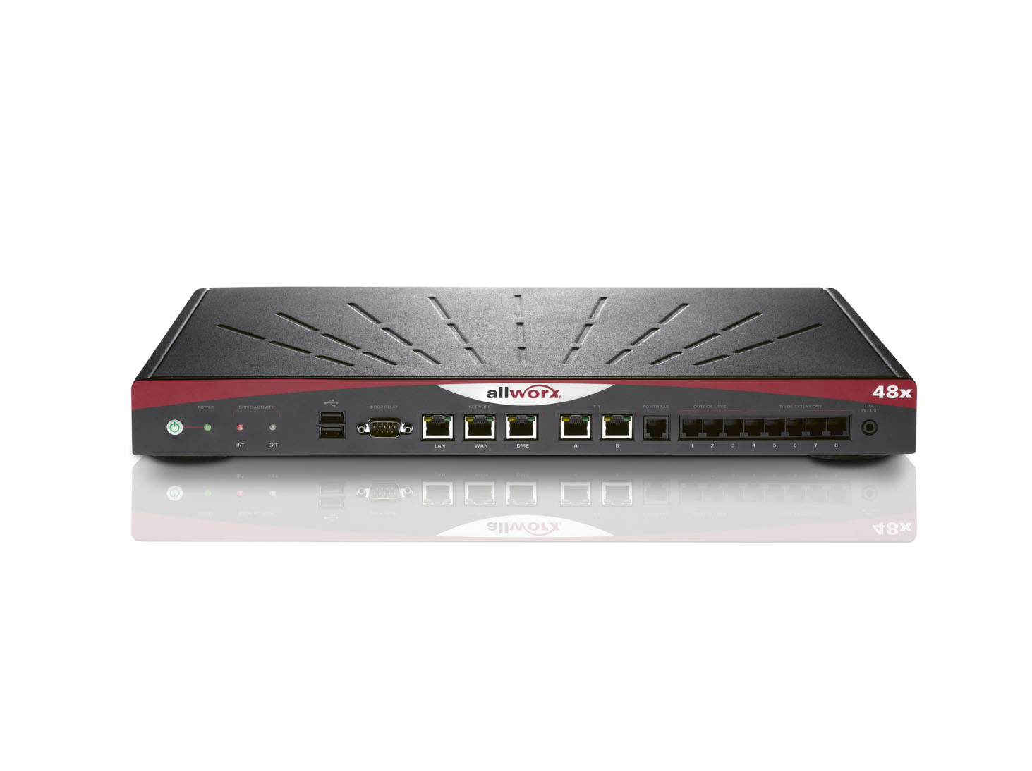
Server Fundamentals
Base server
48 users license - included
Unlimited SIP – included
2 New Optional TI/PRI Licenses

Slide 8
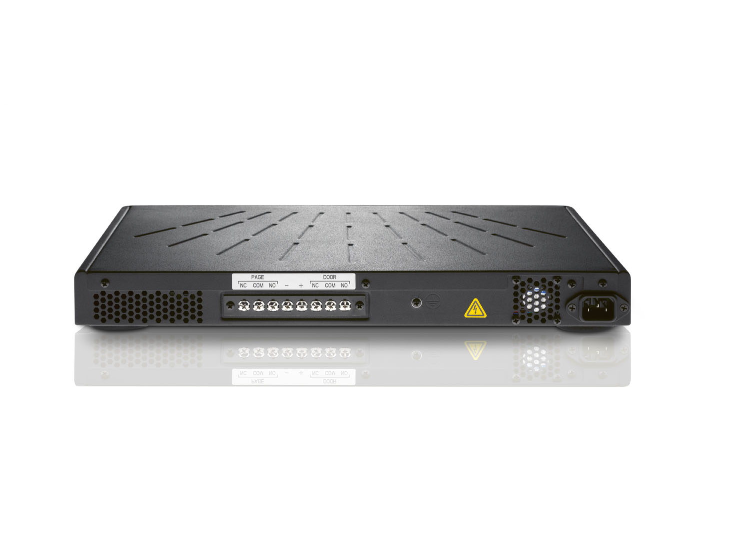
Server Fundamentals
New Terminal Strip
Paging
Door Relay

Slide 9
Feature Key Strategy
Same Feature Key options as 24x
Same Part numbers - Same Pricing
Still server based licenses (good!) - not user based (bad…)
Call Assistant
Dual Language
VPN
Call Queuing
Automatic Call Distribution
Advanced Multi-site - Primary
Advanced Multi-site - Branch
Mobile Link
Conference Center remains the same low price…
New High performance 60 channel DSP
Setup up 4 simultaneous conferences – same as before
Maximum 30 seats per bridge, maximum 60 seats across all bridges
Same easy management interface as before
Same part number (and price) as the 24x

Slide 10
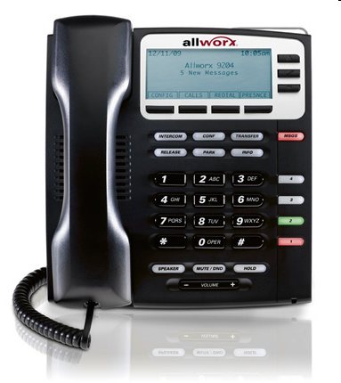
7.2 Software - What’s new?
9204 DSP enhancements
G.722 wide band audio support to other
G.722 audio devices
4-way Conferencing – Phone-hosted 4-way conferencing has been added to Allworx 9204 IP Phones
Whisper Mode Supervision – For agents using Allworx 9204 IP Phones, supervisors can monitor calls using Whisper Mode
The agent can hear the supervisor - but the third party cannot

Slide 11
7.2 Software
Non-Facility Associated Signaling (NFAS) on bonded PRI
Phone Reboot All
Enhanced Phone Plug-N-Play
Improved E911 Support
Multi-site statistics and diagnostics
ACD Enhancements
Busy Handset
Temporary Logout
All Agents Busy
Display ACD queue description
Phone SNMP support

Slide 12
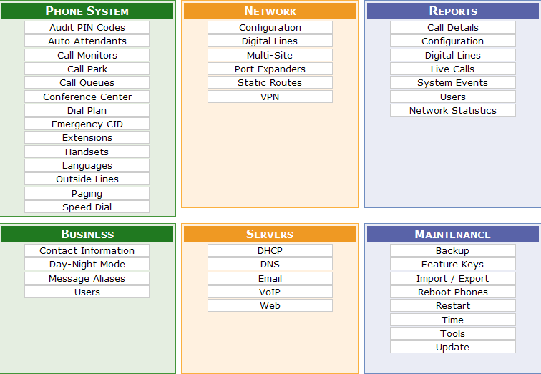
7.2 Software
3 new Tabs
Phone System -Emergency CID
Reports - Network Statistics
Maintenance - Reboot Phones

Slide 13
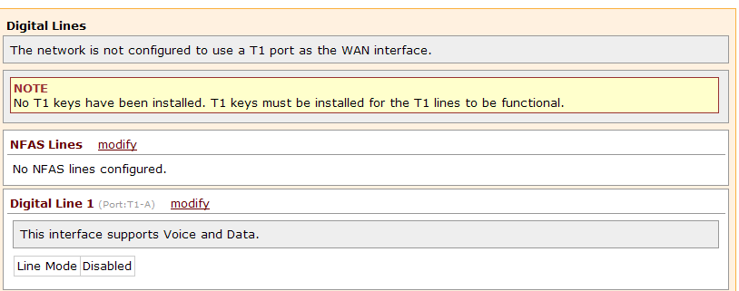
7.2 Software
Non-Facility Associated Signaling (NFAS) on bonded PRI

Slide 14
7.2 Software
Non-Facility Associated Signaling (NFAS) on PRI

Slide 15
7.2 Software
Phone Reboot - All
Technicians delight feature
Larger installations benefit most
Enhanced Phone Plug-N-Play
Phone can be assigned to a user when first registered
A new phone can replace an old phone for a user when the new
phone is connected to the network and powered on
New Call Assistant 2.3.6.0
No enhancements - but with 2.3.5 and earlier, no handsets or
BLF status on screen

Slide 16
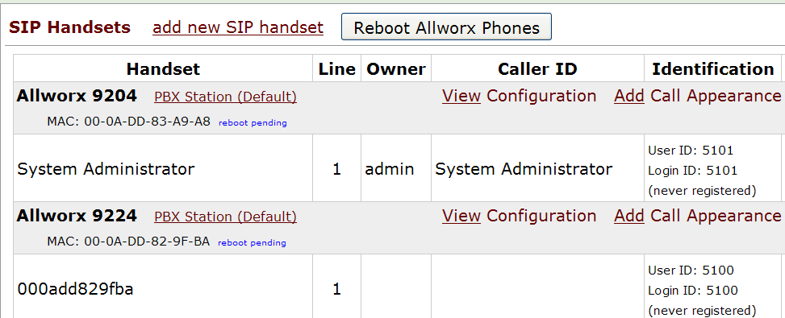
7.2 Software
Phone Reboot-All

Slide 17
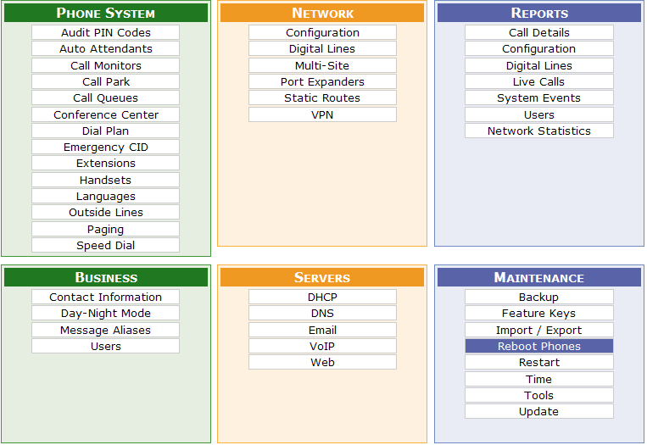
7.2 Software
Reboot All Phones - Automatic Phone Upgrade
All registered phones can be rebooted with one click
Phones will be rebooted at a rate of six (6) per minute
Available on the Handsets page, a new Reboot Phones page, and the Software Upgrade screen
The option to automatically accept phone firmware upgrades eases the system software upgrade process. Phones will accept the firmware update five minutes after being rebooted - permitting the automatic update to be manually rejected if necessary

Slide 18
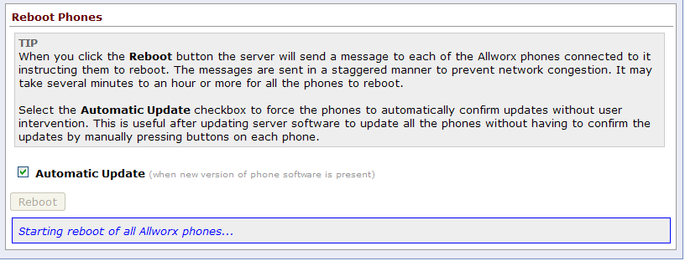
7.2 Software
Reboot Phones -Maintenance

Slide 19
7.2 Software
Improved E911 Support
Allows the creation of multiple E911 CID numbers
Each E911 number will be configured with a phone number, service group, and location name.
Handsets can then be assigned to the E911 number so that when the handset dials 911 the properly configured E911 phone number will be used for all outbound 911 calls.
Benefit - Allows remote phones to setup accurate E911 information if they are located in different physical areas than the main server.

Slide 20
7.2 Software
New section on Admin page

Slide 21
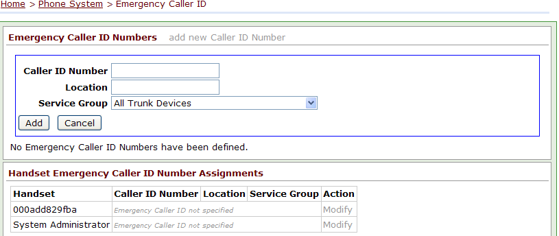
7.2 Software

Slide 22
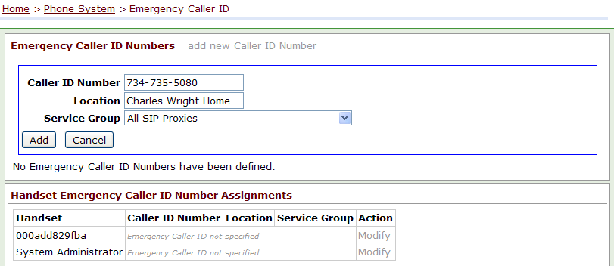
7.2 Software

Slide 23
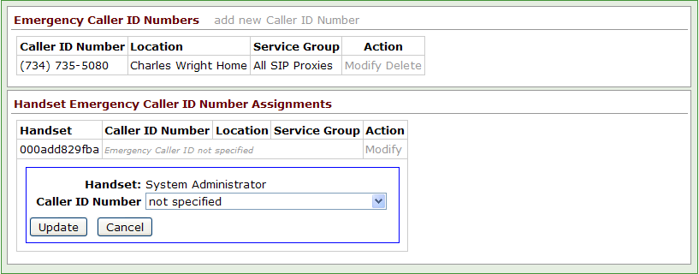
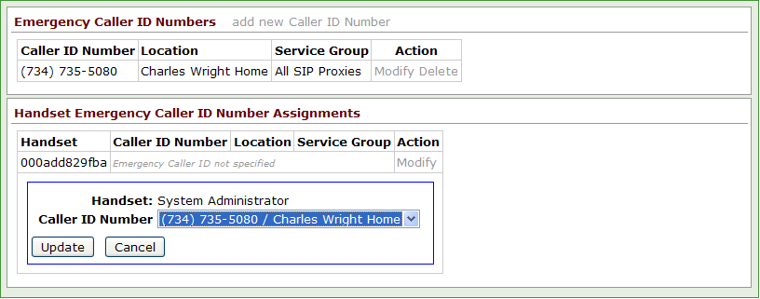
7.2 Software

Slide 24
7.2 Software

Slide 25
7.2 Software
Multi-site statistics and diagnostics
Display the amount of traffic between sites in a multi-site network
Administrators can now determine what can minimize WAN traffic
Installers can test multi-site functionality between different sites
Reduce installation time
Software would allow a test of all the different mechanisms
BLF, voicemail, sip, data traffic
No longer have to be tested manually by the installer

Slide 26
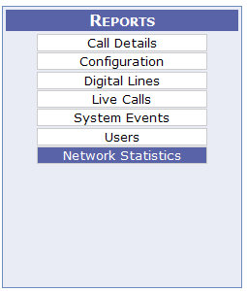
7.2 Software
Multi-site statistics and diagnostics

Slide 27
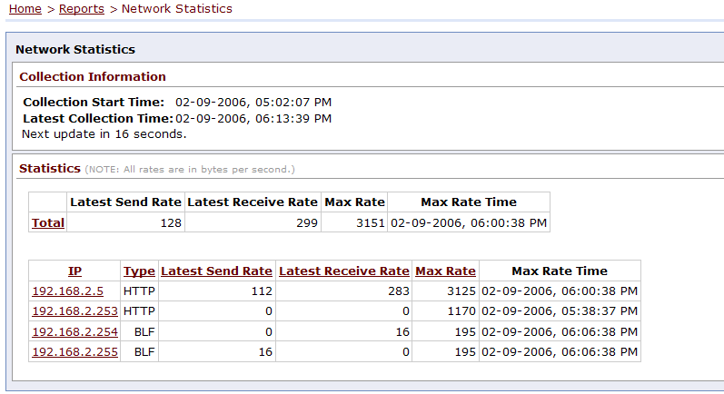
7.2 Software

Slide 28
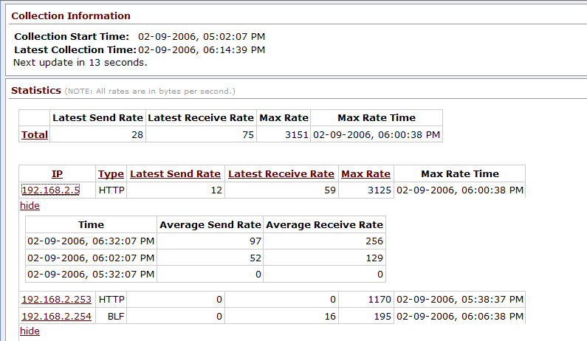
7.2 Software

Slide 29
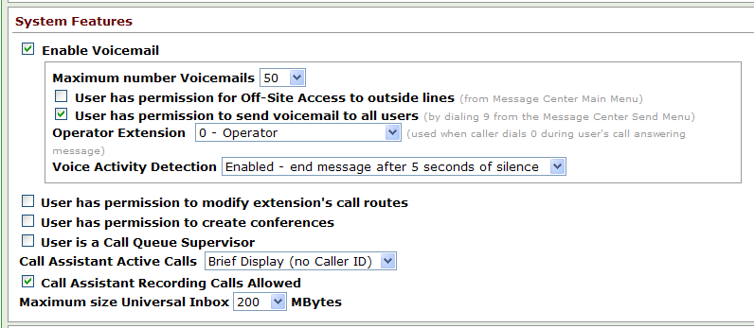
7.2 Software
Call Recording Permission – Call Assistant 2.3.8 or higher can record calls only if granted permission by the Allworx server. The permission setting can be found on the User configuration and User Template pages

Slide 30
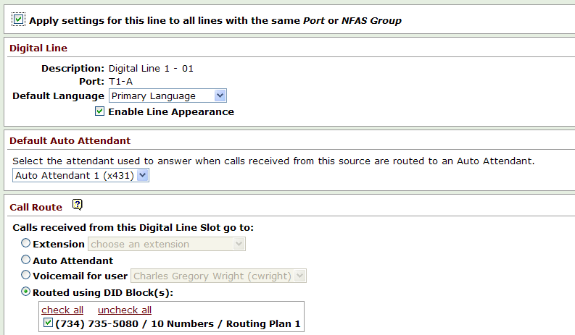
7.2 Software
Outside Lines “Apply to All” Option for Digital Line Channel Configuration
When configuring channels for Digital Lines, option permits the same configuration to be used for all channels. Simplifies setup of call routing.

Slide 31
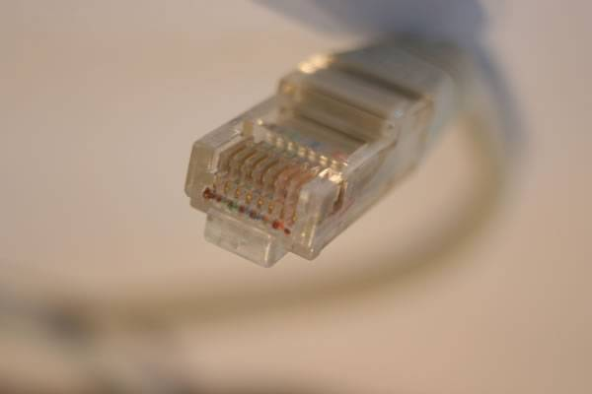
7.2 Software
Enhanced Phone Plug-N-Play
New Phone option – assign to a user
when first registered
When a new phone is connected to the system, an owner can be assigned or an existing Allworx phone can be replaced from menu choices on the phone.
Phone replacement requires the phone administration password
This option is only available on phones that have been upgraded to the firmware contained in Release 7.2.
When the system is upgraded to Release 7.2 for the first time, the feature will not be available.
The capability is available during upgrades to subsequent server releases.

Slide 32
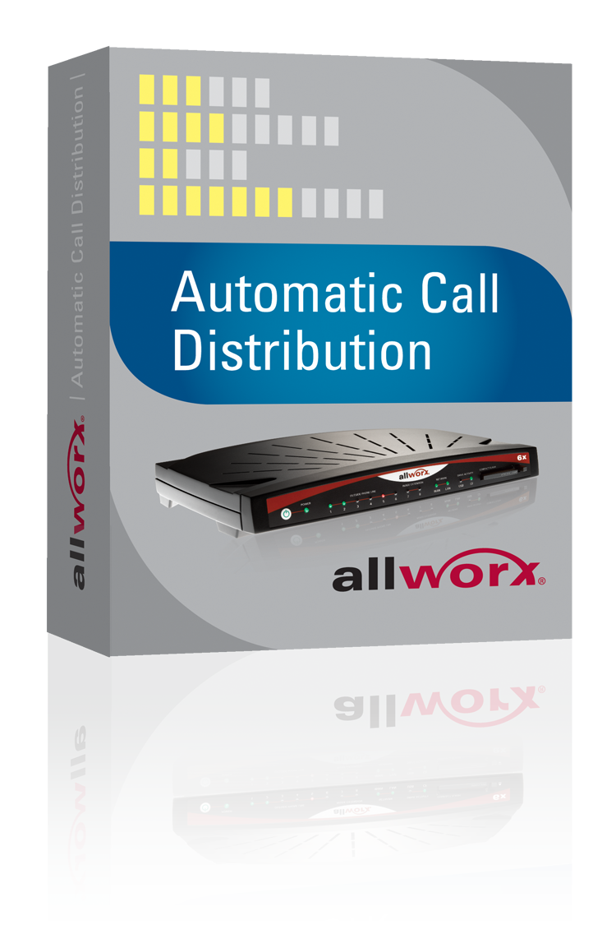
7.2 Software
ACD Enhancements
Busy Handset
Temporary Logout
All Agents Busy
Display ACD queue description

Slide 33
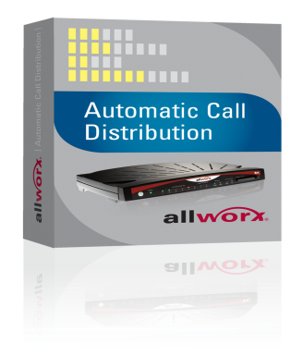
7.2 Software
ACD Enhancements
Busy Handset
Prior to 7.2 calls from an ACD queue
would be distributed to the next available
agent even if the agent was on a non-ACD call.
ACD queues can now be set to enable or disable distributing calls to a busy handset
This setting is on a per ACD queue basis
Default is to distribute calls to a busy handset

Slide 34
7.2 Software
ACD Enhancements
All Agents Busy
ACD Queues can be configured to prevent callers from entering the queue if all agents are busy. The call will follow the defined call route set up for the queue. This can be used to immediately advance callers to be serviced by a backup queue.

Slide 35
7.2 Software
ACD Enhancements
Temporary Logout
An agent can temporarily log out of all ACD queues using the ACD Appearance PFK
When agents are logged into one or more queues they can press and release the PFK to put themselves into a "busy" state for the queue(s); the PFK will slowly blink red
To “un-busy” themselves, the agent must again press and release the PFK; the PFK LED will turn off.
Press and hold for five seconds will display the login screen

Slide 36
7.2 Software
ACD Enhancements
Display ACD queue description
If agents are logged into more than one ACD queue, then the ACD queue description will be displayed on agents’ handsets when the ACD Appearance is ringing

Slide 37
7.2 Software
Phone SNMP support
Phone SNMP Agent
A Simple Network Management Protocol (SNMP) Agent has been added to all Allworx IP phone models. This implementation supports the SNMP GET commands for the following Management Information Bases (MIBs): network services, system, interfaces, SIP-common, SIP-UA, IP, ICMP, TCP, UDP and SNMP. The agent provides the ability for both local and remote phones to be monitored via 3rd-party SNMP management tools. Enable the SNMP agent for an Allworx phone from to the phone’s web administration interface.

Slide 38
7.2 Software
Admin Page on WAN Interface - System Administration can be enabled on the WAN port of Allworx servers that are in any of the NAT/Firewall modes. This feature is enabled by clicking on the checkbox labeled “Allow admin configuration on WAN interface,” on the Network Configuration page.
This feature is not available when using a T1 port as the WAN interface.

Slide 39
7.2 Software – Installation notes
Installation Information
If upgrading from Release 7.0 or lower, you must first upgrade to Release 7.1.
You cannot upgrade directly from Release 7.0 or lower to Release 7.2.
A Software Maintenance Feature Key must be installed on any system being upgraded to Release 7.2.
A new version of the Allworx Call Assistant software (2.3.8) is available and is required for compatibility with Release 7.2.
Release 7.2 for Allworx 10x servers is not yet available.
Allworx 10x servers should run the highest 7.1 patch release until 7.2 for the 10x is released

Slide 40
7.2 Software – additional notes
This release should not be installed while the server is in Safe Mode.
Installation should be done in Normal Mode using the Maintenance / Update screen.
If the server will only boot into Safe Mode, restore a backup of the previous load then use the Update screen to load this release.
There are separate software distributions for each of the Allworx server models (except 10x, at this time).
It is very important to install the software version that is intended for your server. If upgrading over the Internet, the Allworx server will automatically choose the correct file.
If you are installing the software using the installation files manually downloaded from the Allworx Portal, make sure you have the correct files:
Phone firmware is completely common between the Allworx server products. Phones are inter-operable between different server models.

Slide 41
A Few New Catalog Numbers
Lower Starting Price !
Description | Catalog Number | Partner List | MSRP
48x base, SIP, 48 Users | 8200054 | $ 1,995 | $ 3,990
1st T1/PRI | 8210041 | $ 950 | $ 1,900
2nd T1/PRI | 8210042 | $ 1,800 | $ 3,600
151-200 users | 8210048 | $ 2,600 | $ 5,200
201-250 users | 8210049 | $ 2,900 | $ 5,800
48x Demo kit (inc T1/PRI) | 8200056 | $ 2,625

Slide 42
Pricing, continued
Lower entry level - SIP with 48 Users
Partner | SIP only | 1 T1/PRI | 2nd T1/PRI
48 users | $ 1,995 | $ | $
49-100 users | $ | $ | $
101-150 users | $ | $ | $
151-200 users | $ | $ | $
201-250 users | $ | $ | $

Slide 43
48x Moving forward
Dual T1 / PRI supporting NFAS Up to 250 users allow for access to higher density environments
Solid state drive (8GB) replaces hard disk provide improved reliability
Larger Conference Bridge options providing enterprise type functionality
7.2 software continued excellence and innovation
Same competitive pricing

Slide 44
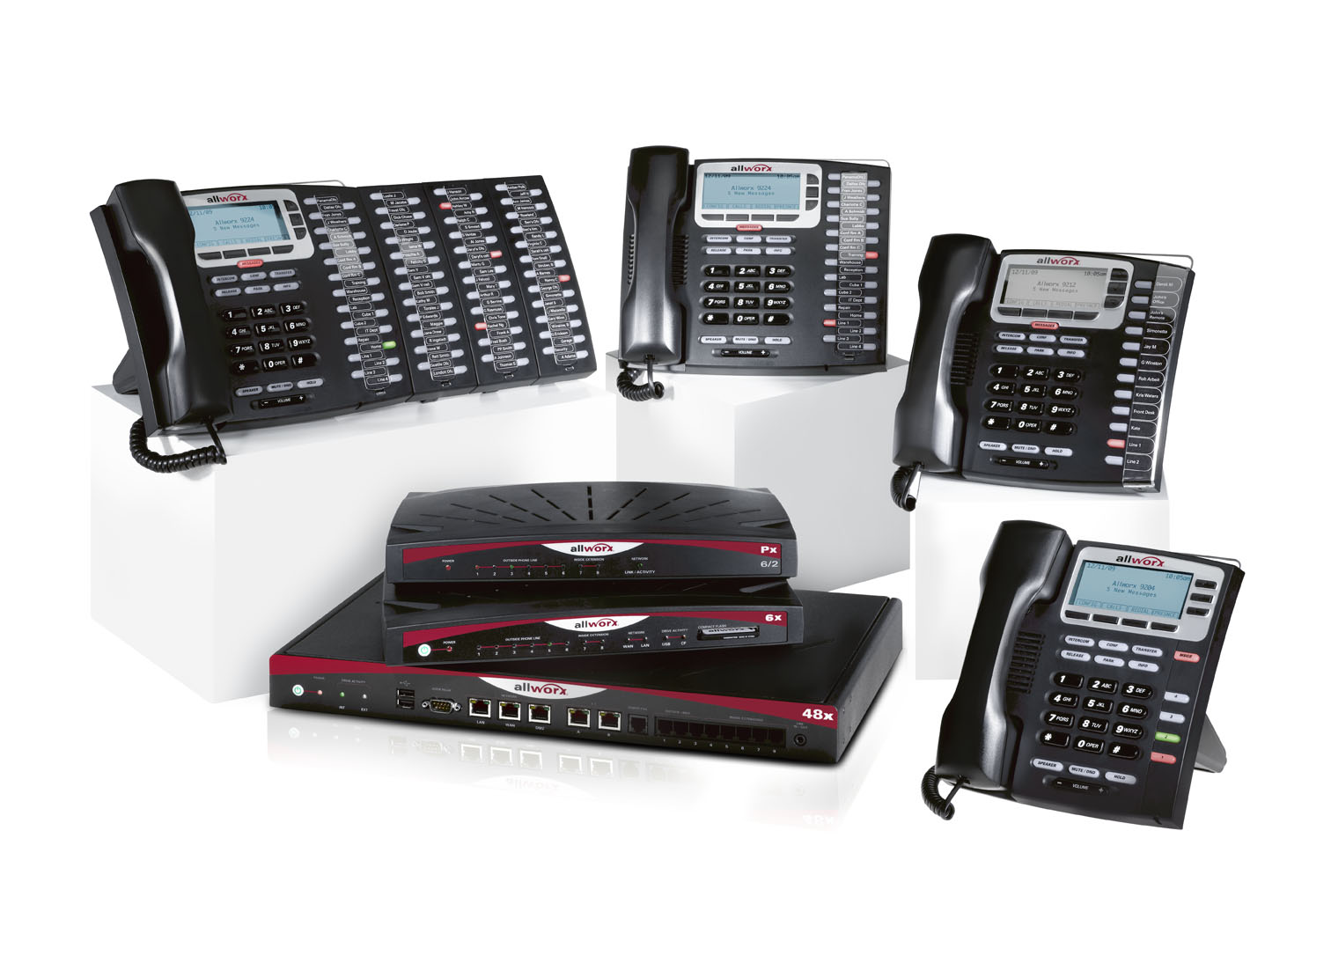
The new Product Family

Slide 45
Questions ?

